Slide 1
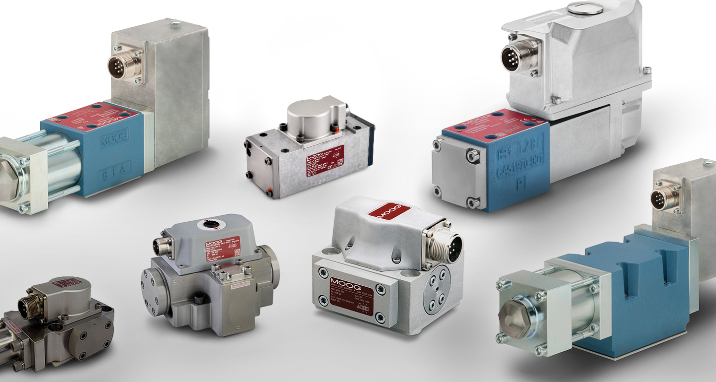
Servo Valve Technology
Overview of Function, Components, and Application
Ali Taha Mohammed
Regestration number: 24126191

Slide 2
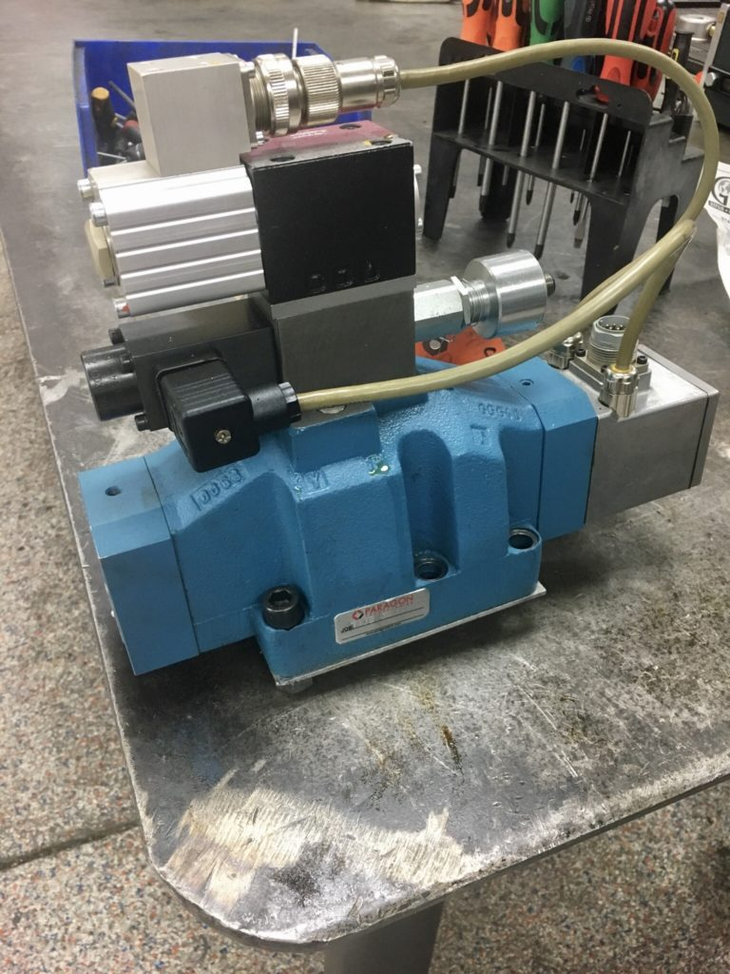
What is a Servo Valve?
Servo valves are a type of directional control valve that precisely regulates fluid flow using an electrical signal. They are essential components in hydraulic systems, enabling precise control over the movement and positioning of actuators

Slide 3
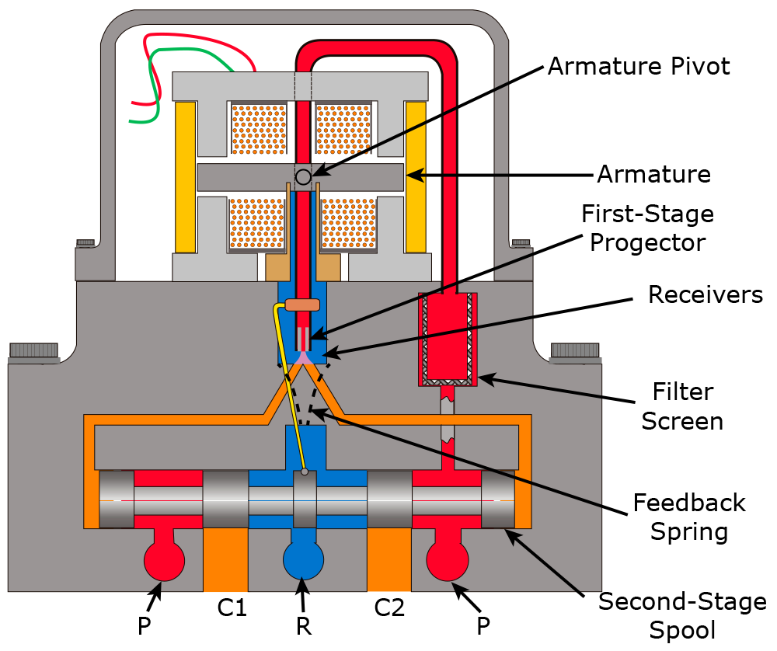
Working Principle of Servo Valves
Servo valves operate based on the principle of converting an electrical signal into precise mechanical movement to control fluid flow. The key components of a servo valve include a torque motor, a feedback mechanism, and a spool. When an electrical signal is applied, the torque motor generates a torque that moves the spool. This movement regulates the flow of hydraulic fluid by opening or closing passages within the valve. The feedback mechanism ensures that the spool's position accurately corresponds to the input signal, allowing for precise control of actuator movements

Slide 4
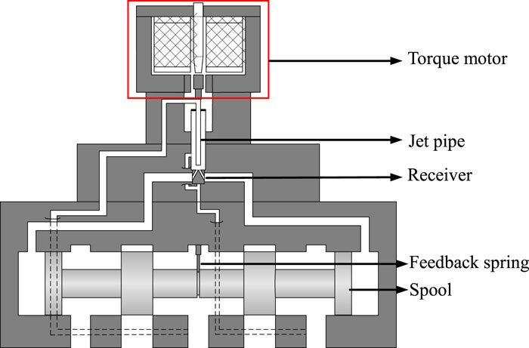
Main Components of Servo Valves
Torque Motor: Converts electrical signals into mechanical movement, generating the torque required to move the spool.
Spool: The movable part inside the valve that regulates the flow of hydraulic fluid by opening or closing passages.
Feedback Mechanism: Ensures the spool's position accurately matches the input signal, providing precise control.
Nozzle and Flapper: These components work together to control the flow of fluid to the spool, allowing fine adjustments.
Body: The main housing that contains all the internal components and provides the connection points for hydraulic lines.

Slide 5
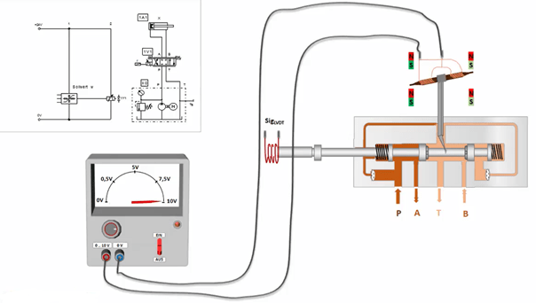
Types of Servo Valves
Servo valves can be classified into two main types:
1.Electro-Hydraulic Servo Valves: These valves use an electric signal to control hydraulic fluid flow. They consist of a torque motor that converts electrical inputs into mechanical movements, which in turn position the valve spool to regulate fluid flow.
2.Mechanical Servo Valves: These valves use mechanical linkages to control the position of the valve spool. They are typically simpler and do not rely on electrical signals for operation.

Slide 6
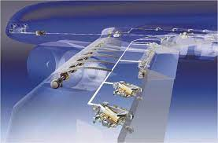
Practical Applications of Servo Valves
Servo valves are used in a variety of applications across different industries due to their precision and responsiveness:
1.Industrial Automation: Used in machinery and equipment to control actuators with high precision.
2.Aerospace: Essential for controlling the movement of flight control surfaces and landing gear.
3.Robotics: Provide precise control of robotic arms and other components, enabling complex movements.
4.Automotive: Used in advanced systems like active suspension and steering controls.

Slide 7
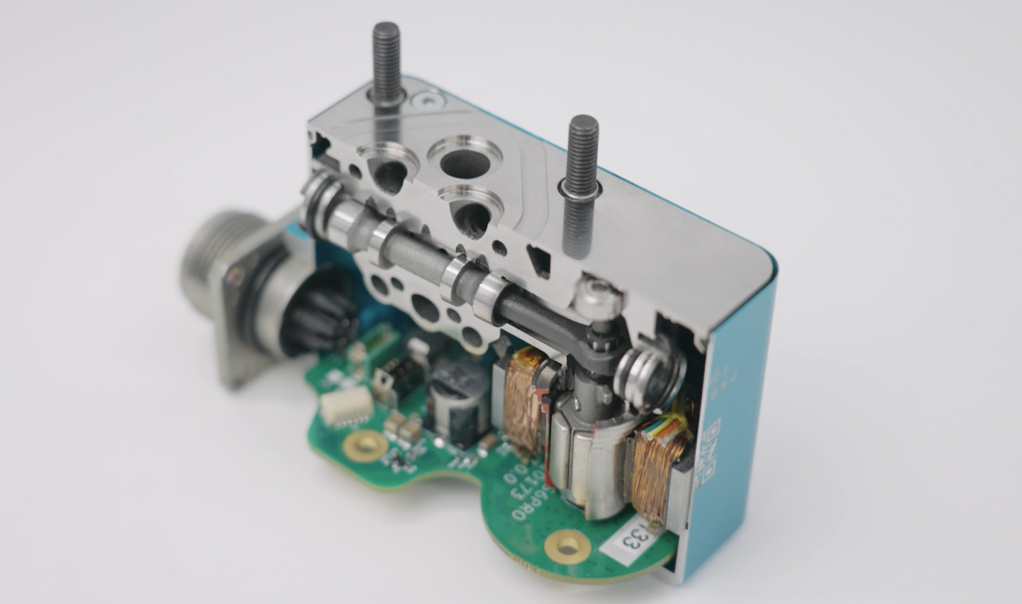
Advantages of Servo Valves
1.High Precision: They provide extremely accurate control of position, velocity, and acceleration, which is essential for applications requiring fine adjustments.
2.Fast Response: Servo valves can make rapid adjustments, thanks to their closed-loop control systems, making them ideal for dynamic environments.
3.Versatility: They can be used in a wide range of applications across various industries, from aerospace to robotics.

Slide 8
Conclusion
servo valves are a critical component in modern hydraulic systems, offering high precision and fast response times. Despite some challenges like the need for regular maintenance and higher costs, their benefits make them invaluable for many applications. As technology advances, we can expect even more efficient and cost-effective servo valve solutions in the future.

Slide 9
Thank You & Questions

